Slide 1
Zacamo - .Net Solo Project
Zack Mitchell

Slide 2
Roadmap
Use Case Diagram
Class Diagram
Finished Product
Entity Code First
WCF
MVC
Testing
Reflection

Slide 3
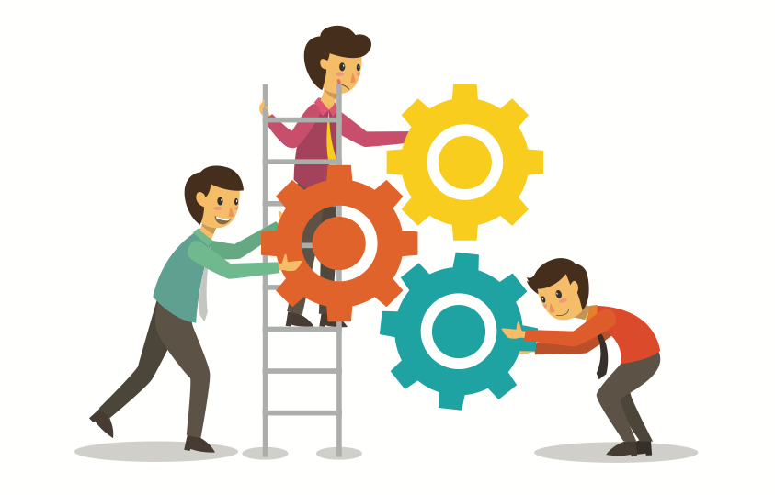
Organisation

Slide 4
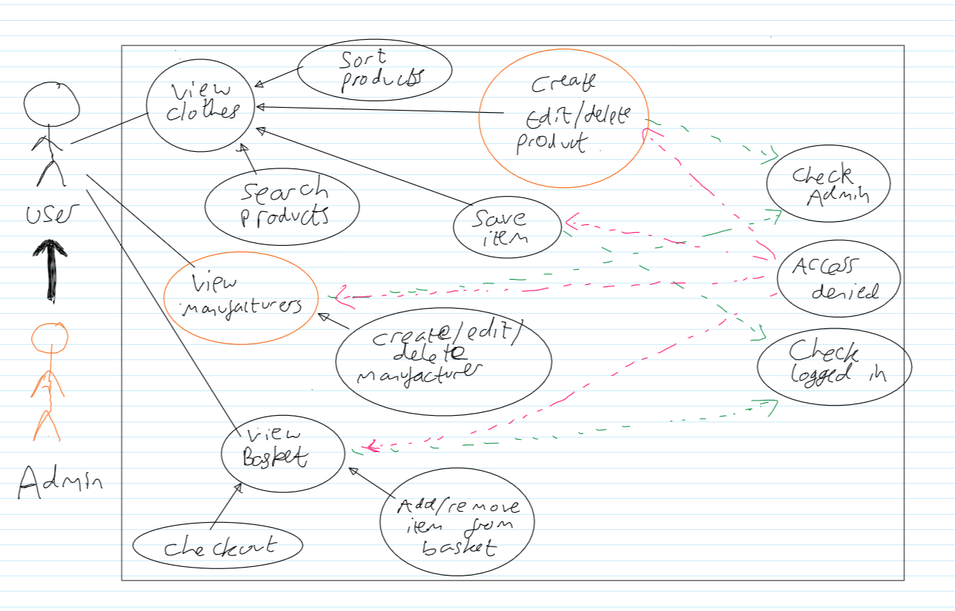
UML – Use Case Diagram
Zacamo

Slide 5
UML – Class Diagram
Repositories
https://creately.com/diagram/k9v45icp2/U92cVA0vH8xqFVOvGjDJR3mWDU%3D
WCF
https://creately.com/diagram/k9v5s7et1/IJ0rmroCvVtC07X3NK3mUzLHQ%3D
MVC
https://creately.com/diagram/k9vaw8zt1/mLvExL20Qr3i4vOG7g3ZfZZB6q8%3D

Slide 6
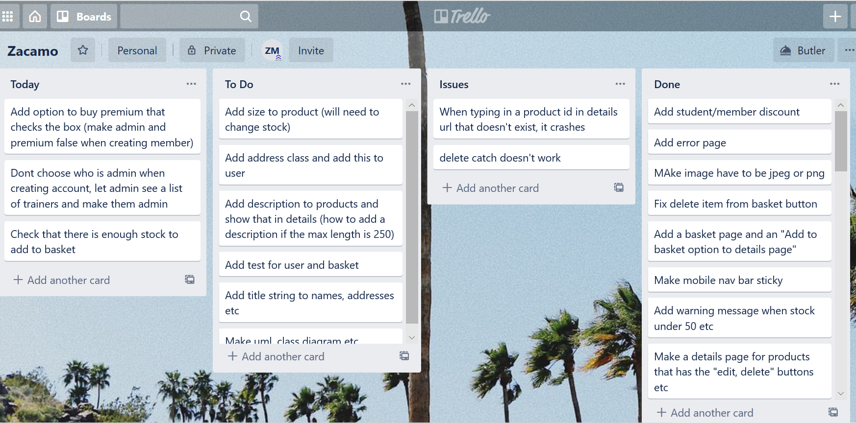
Kanban Board

Slide 7

The Finished Product

Slide 8
Website Features - Products
Filtering and searching products
Sort products by price etc
Create new manufacturer
Create new product (only letting jpeg or png image)
Show a product with no or low stock

Slide 9
Website Features - Accounts
Registering (check password matches and is in right format and email is not in use)
Features for a normal user
Buying premium
Edit account details and password
Delete Account

Slide 10
Website Features - Basket
Can only add to basket when logged in
Adding product to basket
Checkout (show stock goes down)

Slide 11
Website Features - Other
Saving Products
Changing members admin
Error page
Mobile version
Favicon

Slide 12

The code

Slide 13
Entity Framework - Code First
Creating entities
Creating repositories
Testing repositories using effort
Show Database

Slide 14
WCF
This is the service layer
Takes requests from the controllers and responds to them. It lets the website use the repositories
There is a loose coupling between the client and the service so they don’t need to know how each other works
Uses a HTTP host

Slide 15
ASP .Net
Used MVC design pattern to separate concerns (each part does one thing)
Models
Views
Controllers

Slide 16
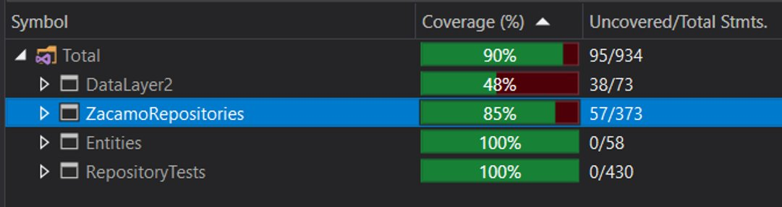
Testing
Used Effort to moq the database
Code coverage:

Slide 17
Further Updates
Adding a stock entity with stocks for the different sizes of product
When someone adds a product to their basket, it should be marked on the database because it only takes it off the stock amount when checking out and this could cause errors when the product is sold out
Would need to add a proper purchasing system that checks a card is valid etc

Slide 18
Reflection
Don’t rush in to the project – I had to remake the basket repository and change the product entity multiple times because I didn’t plan everything out fully which wasted some time.
I have learnt how to manipulate data in a database using Entity Framework and LINQ to show the relevant aspects to the user
How to implement the OOD principles and make an application that solves a business problem

Slide 19
Reflection
Why MVC is useful – Could change the repositories etc without having to change the views to fit the new code as there is a loose coupling between them
Security – encrypting passwords with a salt, giving admin permissions
Making a clean, responsive website where the user can interact with the many features

